Slide 1
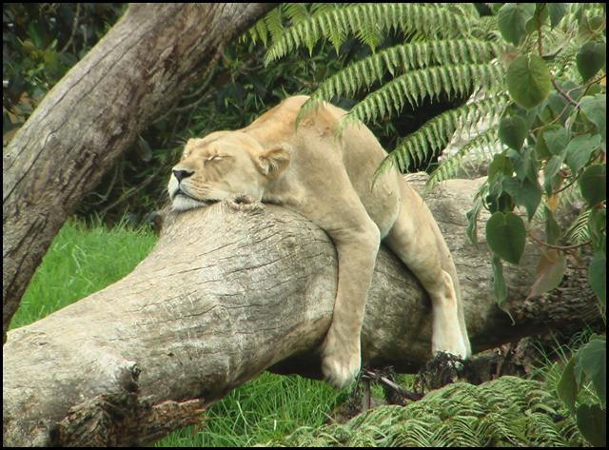
Safari Adventure
Welcome to your first …
Kym Raymond
Elodie
Félix

Slide 2
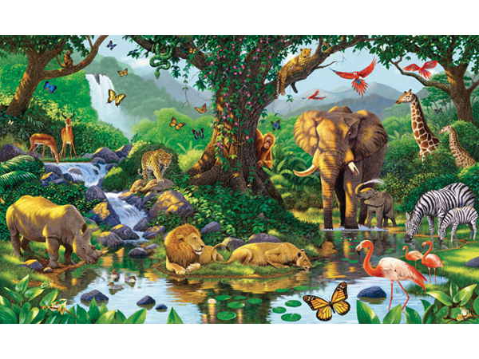
Next Adventure

Slide 3
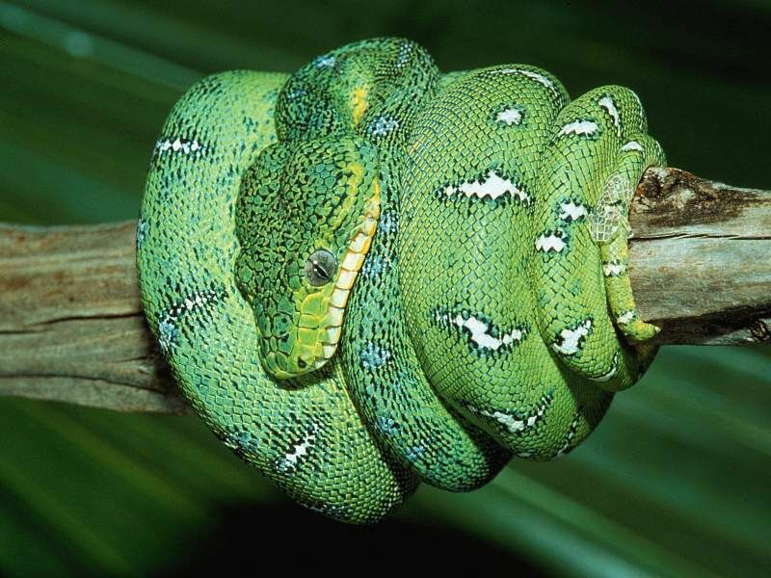
Snake
A snake has a long body a long tongue and some have rattles at the tip of their tail.
Next

Slide 4
Next Adventure

Slide 5
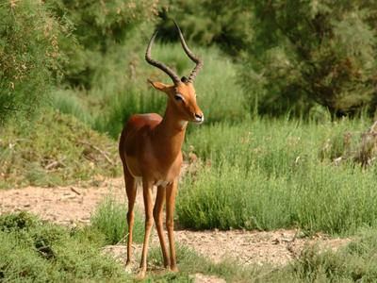
Antelope
An antelope is brown and beige, it has long horns and has
long thin legs.
Next

Slide 6
Next Adventure

Slide 7
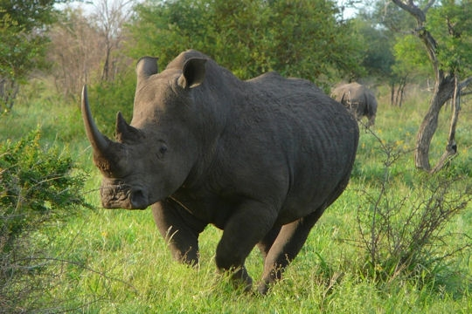
Rhinoceros
A rhinoceros is big and grey. It has a
short horn
and a
long horn.
Next

Slide 8
Next Adventure

Slide 9
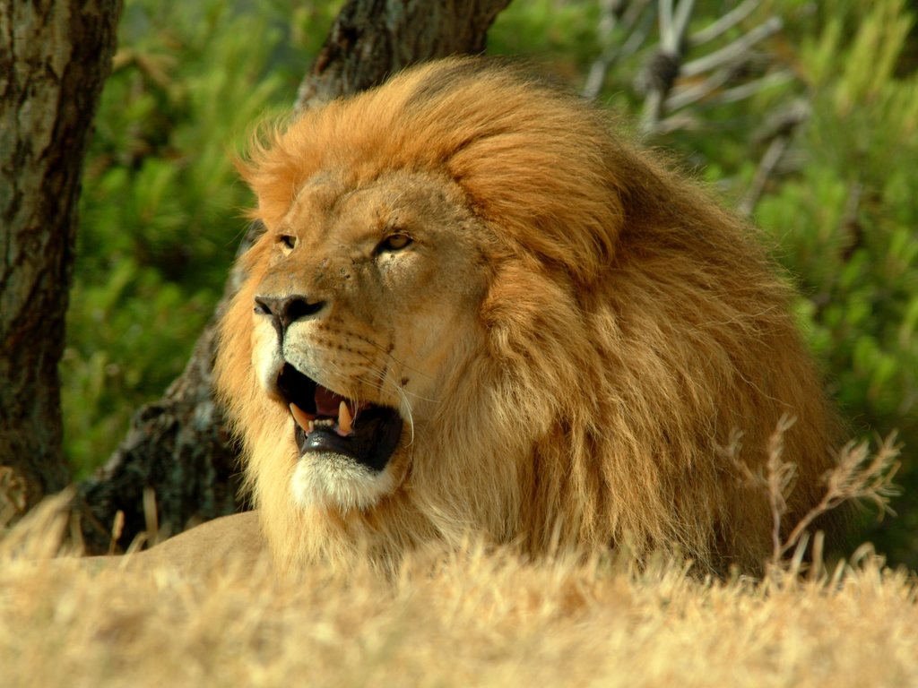
Lion
A lion is yellow, it has a
big mane,
long teeth and a
big nose.
Next

Slide 10
Next Adventure

Slide 11
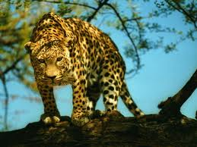
Leopard
A leopard is yellow with black spots. It has
small ears, a long tail and sharp claws
Next

Slide 12
Next Adventure

Slide 13
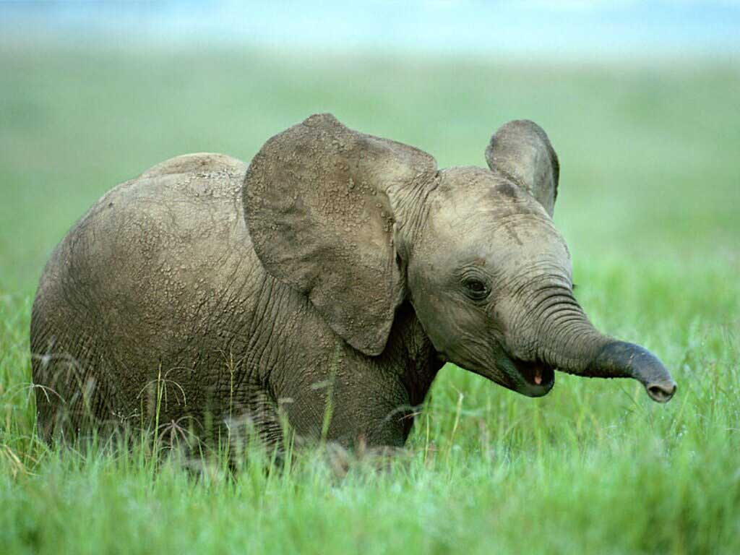
Elephant
An elephant is grey,
it has
big ears
and a
long trump.
Next

Slide 14
Next Adventure

Slide 15
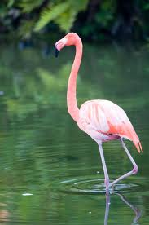
Flamingo
A flamingo is pink, it has a long curved beak and long legs.
Next

Slide 16
Next Adventure

Slide 17
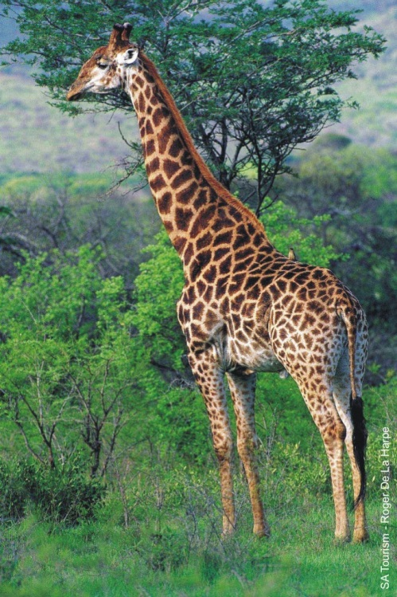
Giraffe
A giraffe is yellow with brown spots. It has a
long neck and a
short mane.
Next

Slide 18
Next Adventure

Slide 19
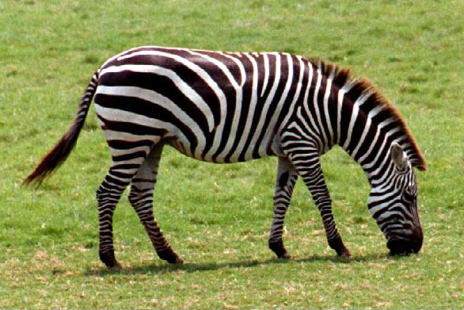
Zebra
A zebra is black with white stripes. It has a
short mane and small ears.
Next

Slide 20
Next Adventure

Slide 21
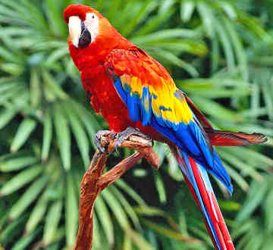
Parrot
A parrot has many bright colours.
It has a
long beak, long tail and has
big wings.
Next

Slide 22
Next Adventure

Slide 23
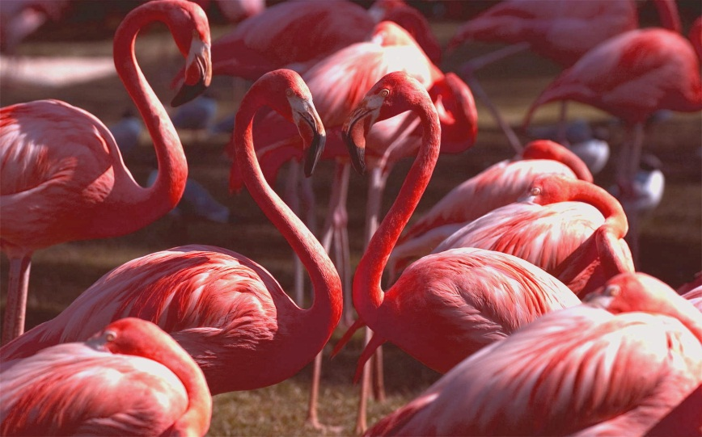
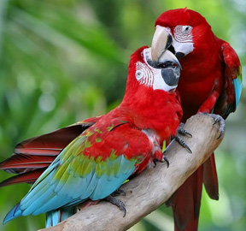
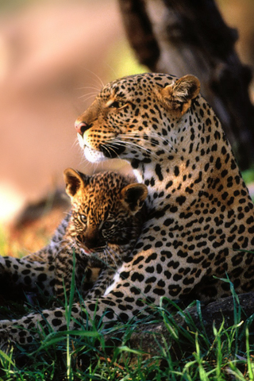
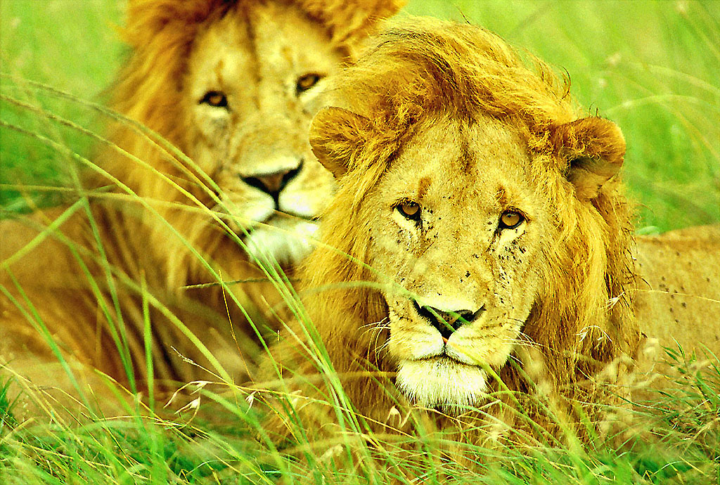
Choose the right plural form for each animal.
flamingos
flamingoes
flamingos
parrots
flamingoes
parots
parrots
parots
lians
lions
lians
lepards
lions
leopards
lepards
Next adventure
leopards

Slide 24
Oops… spelling mistake ☹
Try again

Slide 25
Choose the right plural form for each animal.
flamingos
flamingoes
flamingos
parrots
flamingoes
parots
parrots
parots
lians
lions
lians
lepards
lions
leopards
lepards
Next adventure
leopards

Slide 26
Wrong animal ☹
Try again

Slide 27
Choose the right plural form for each animal.
flamingos
flamingoes
flamingos
parrots
flamingoes
parots
parrots
parots
lians
lions
lians
lepards
lions
leopards
lepards
Next adventure
leopards

Slide 28
Very Good ☺

Slide 29
Choose the right plural form for each animal.
flamingos
flamingoes
flamingos
parrots
flamingoes
parots
parrots
parots
lians
lions
lians
lepards
lions
leopards
lepards
Next adventure
leopards

Slide 30
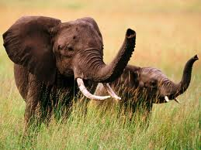
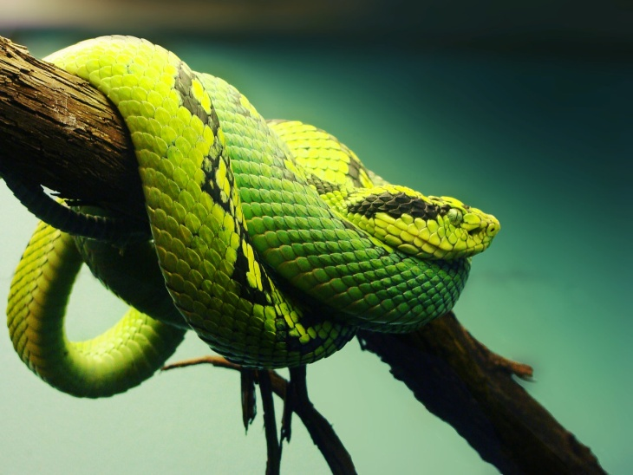
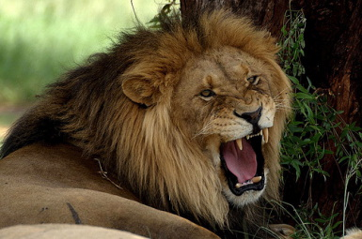
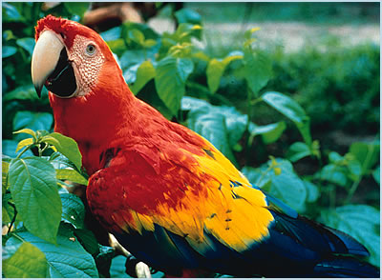
Animal sounds
An elephant trumpets.
A snake hisses.
A parrot screeches.
next
A lion roars

Slide 31
Choose the right answer.
The elephant ...
Roars
Hisses
Screeches
Trumpets

Slide 32
Choose the right answer.
The lion...
Roars
Hisses
Screeches
Trumpets

Slide 33
Choose the right answer.
The snake ...
Roars
Hisses
Screeches
Trumpets

Slide 34
Choose the right answer.
The parrot ...
Roars
Hisses
Screeches
Trumpets

Slide 35
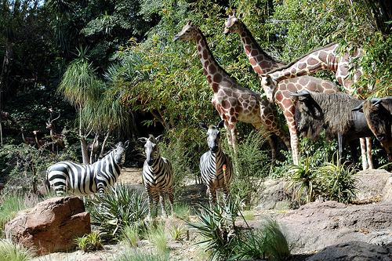
Good job!
You have completed the quiz!

Slide 36
That’s right!
The elephant trumpets.
Next

Slide 37
That’s right!
The lion roars.
next

Slide 38
That’s right!
The snake hisses.
next

Slide 39
That’s right!
The parrot screeches.
next

Slide 40
Good job!
You have completed the quiz!

